Slide 1
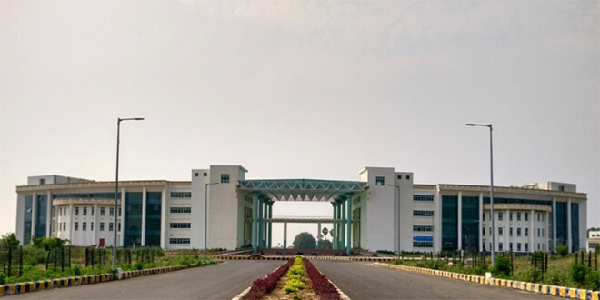

ns-3
Dr. Rajiv Misra
Associate Professor
Dept. of Computer Science & Engg.
Indian Institute of Technology Patna
rajivm@iitp.ac.in
ns-3

Slide 2
Lets Learn Something New ☺
Fourth.cc
fifth.cc
sixth.cc

Slide 3
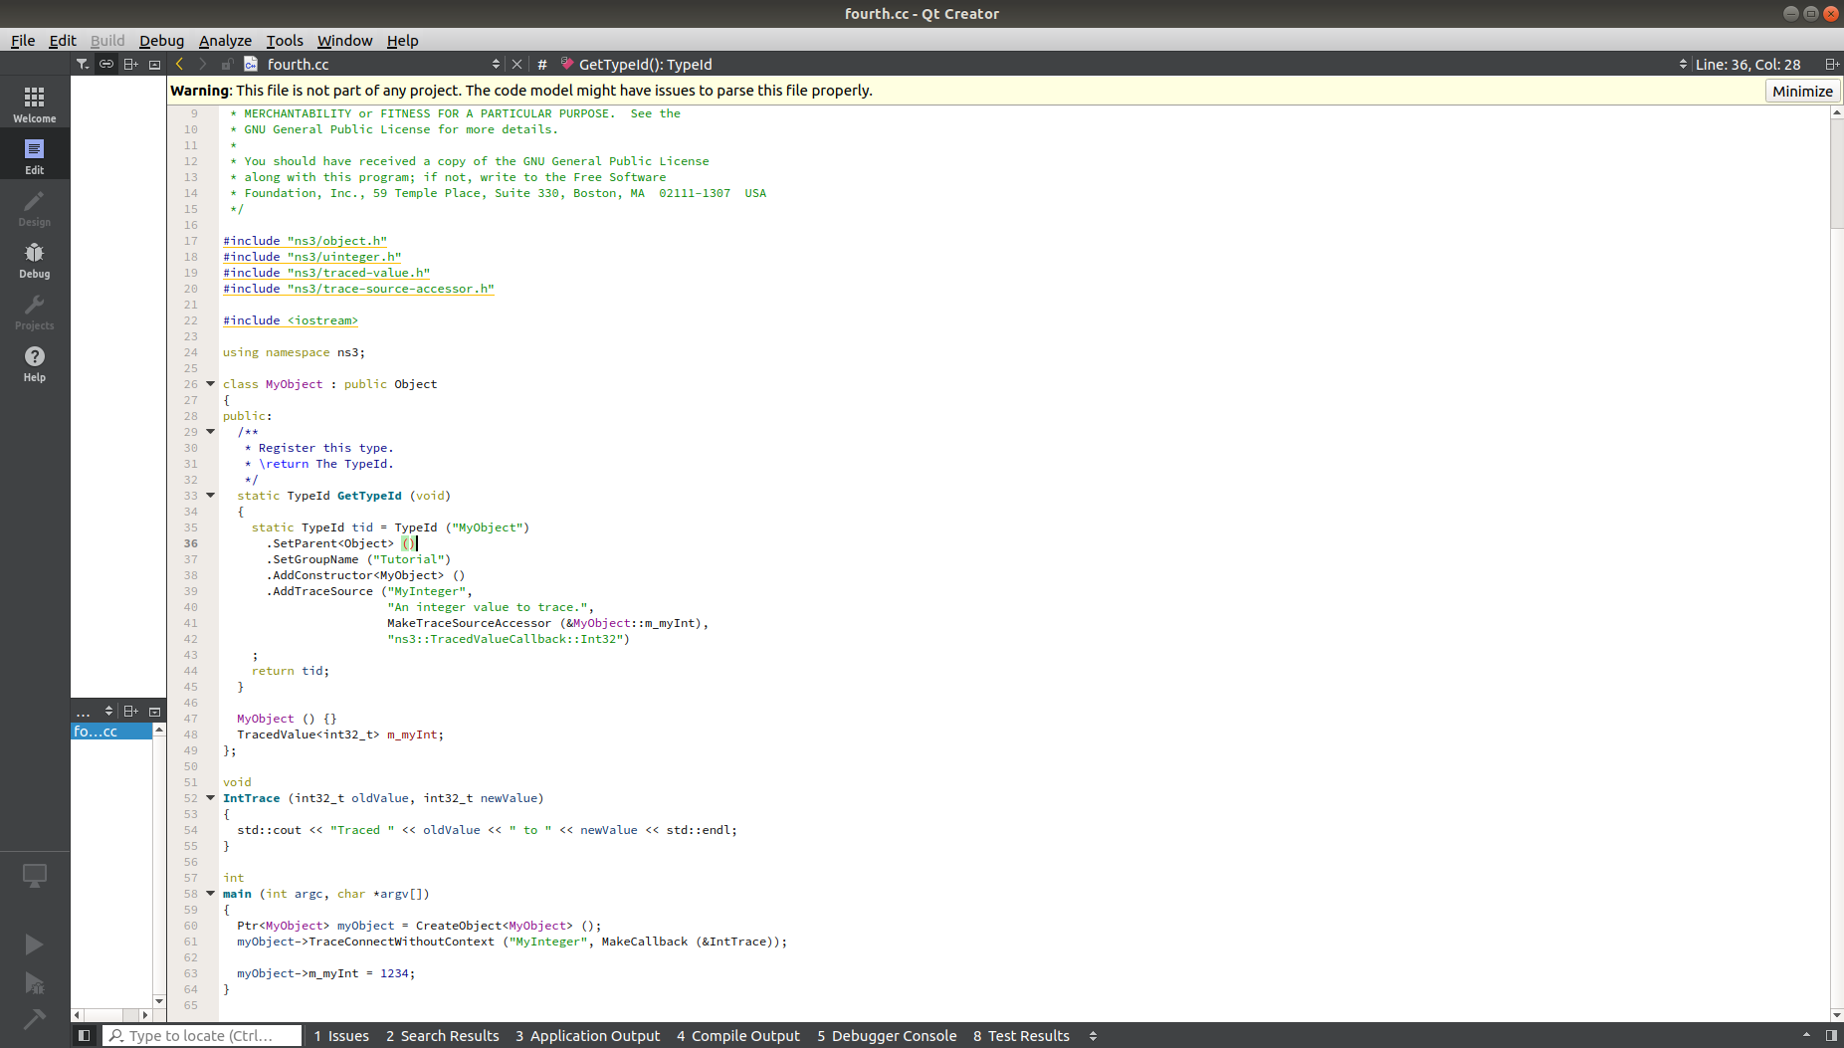
Fourth.cc

Slide 4
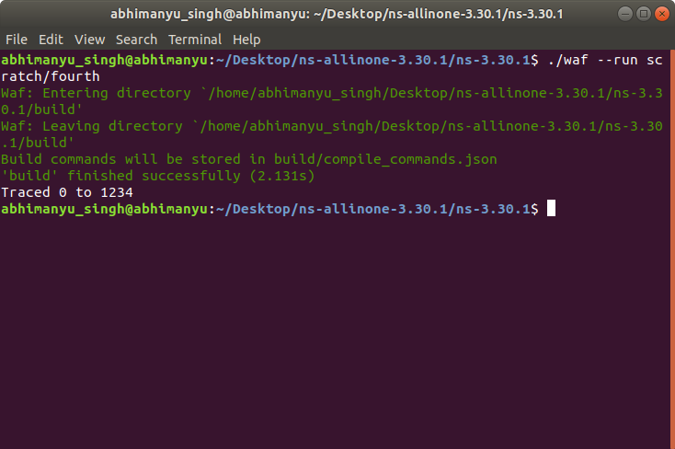
OUTPUT fouth.cc

Slide 5
Fifth.cc
We want to look at changes in the ns-3 TCP congestion window. We need to crank up a flow and hook the Congestion Window attribute on the socket of the sender. Normally one would use an on-off application to generate a flow, but this has a couple of problems. First, the socket of the on-off application is not created until Application Start time, so we wouldn't be able to hook the socket (now) at configuration time. Second, even if we could arrange a call after start time, the socket is not public so we couldn't get at it. So, we can cook up a simple version of the on-off application that does what we want. On the plus side we don't need all of the complexity of the on-off application. On the minus side, we don't have a helper, so we have to get a little more involved in the details, but this is trivial. So first, we create a socket and do the trace connect on it; then we pass this socket into the constructor of our simple application which we then install in the source node.

Slide 6
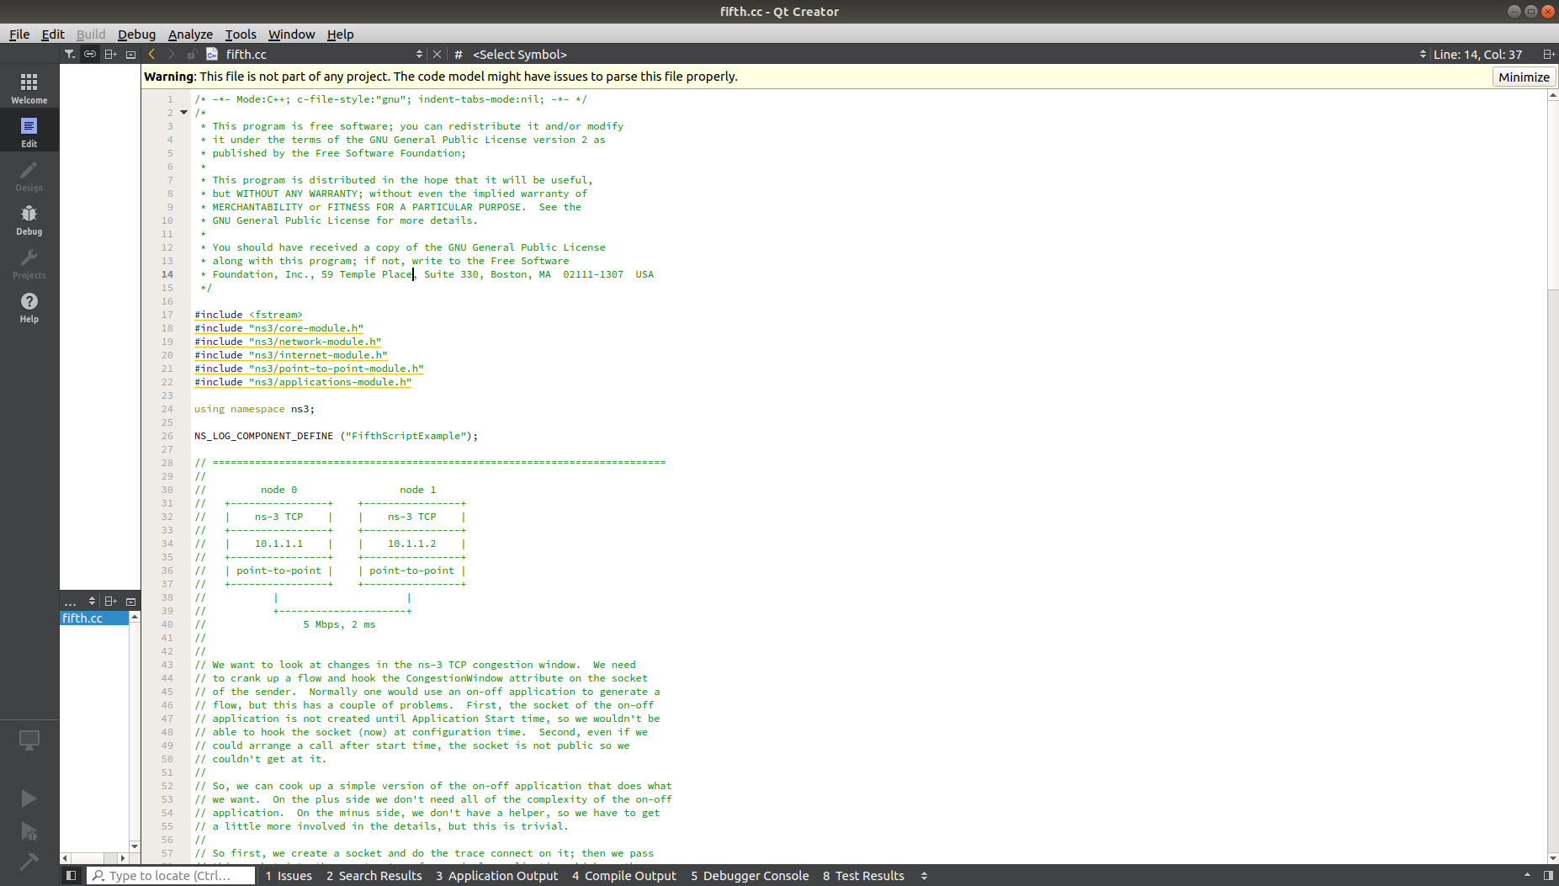
Fifth.cc

Slide 7
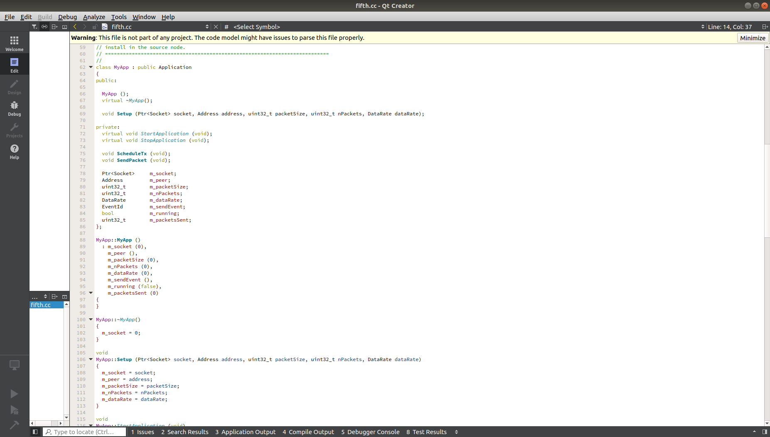
Fifth.cc

Slide 8
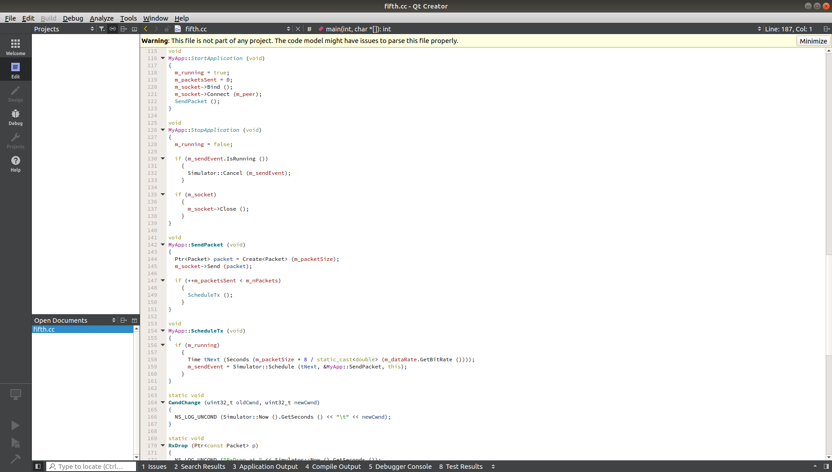
Fifth.cc

Slide 9
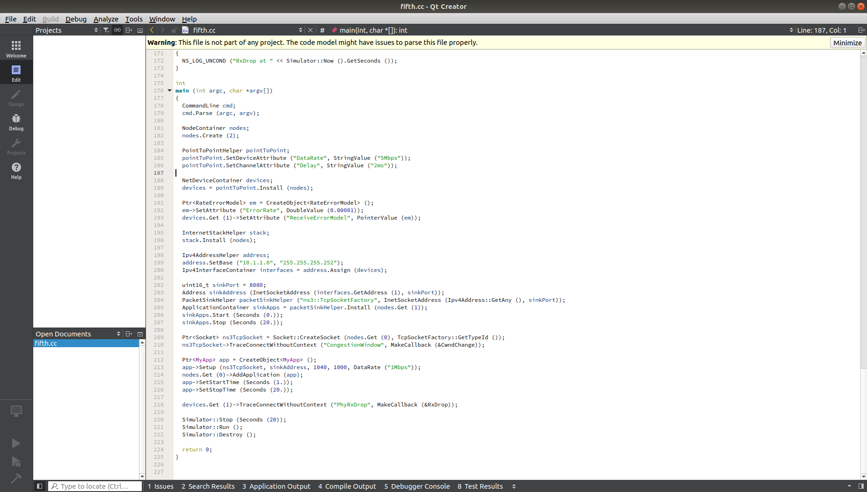
Fifth.cc

Slide 10
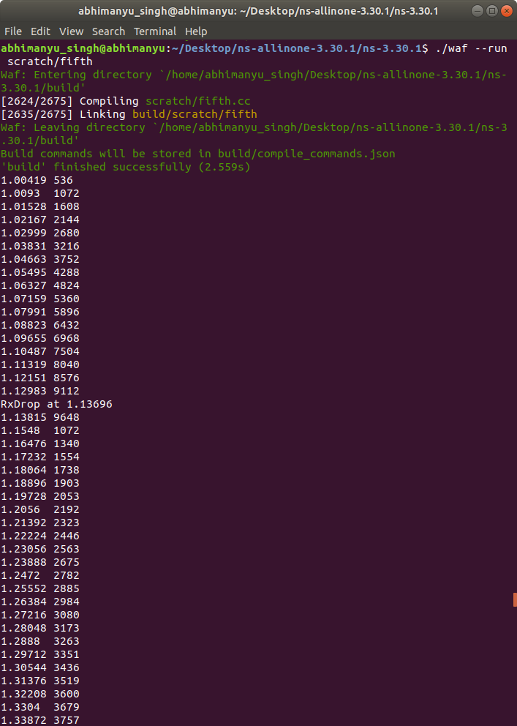
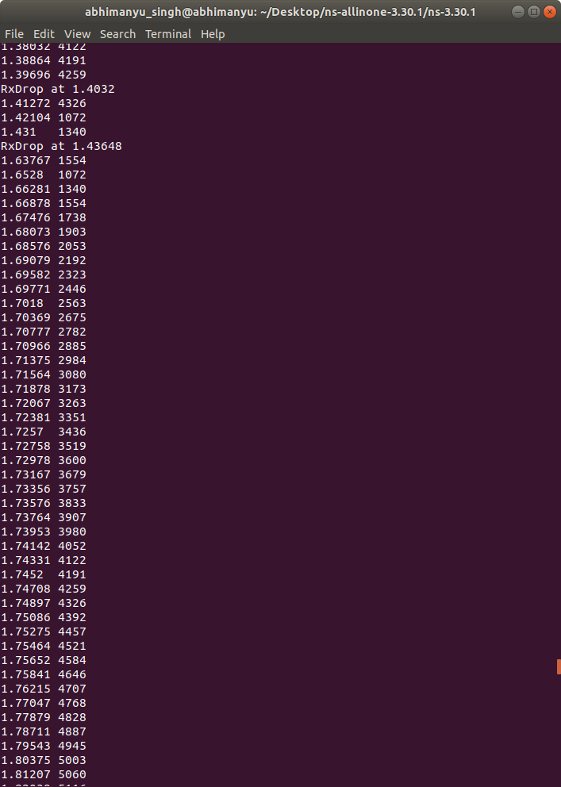
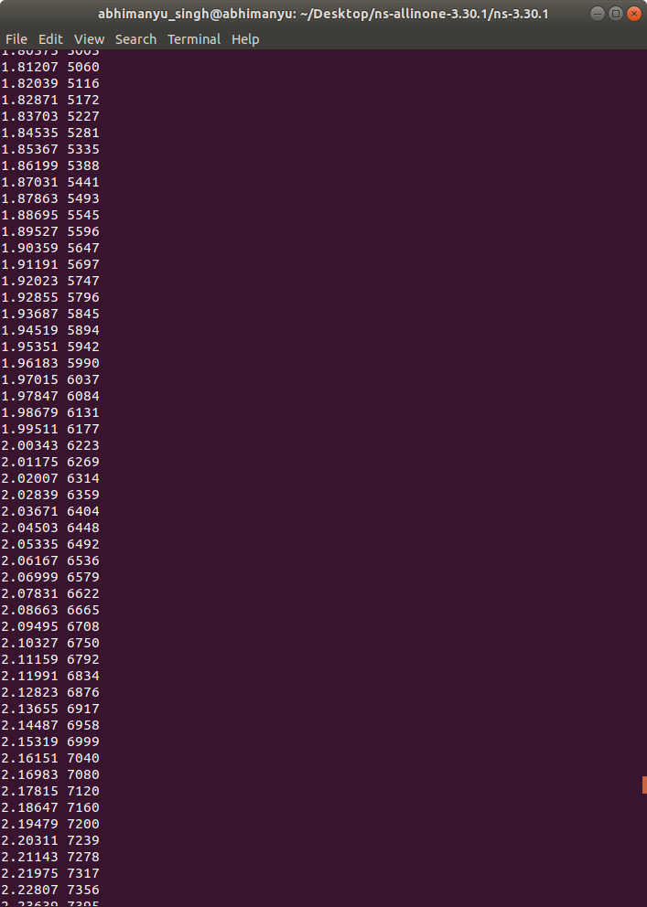
OUTPUT

Slide 11
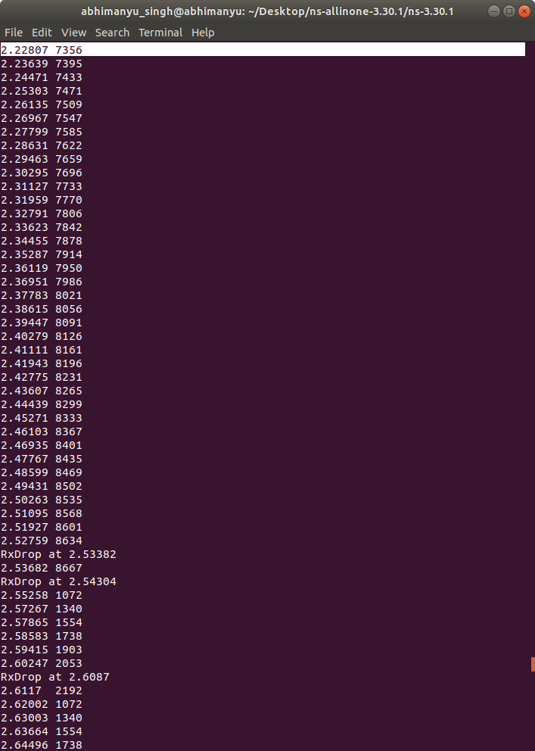
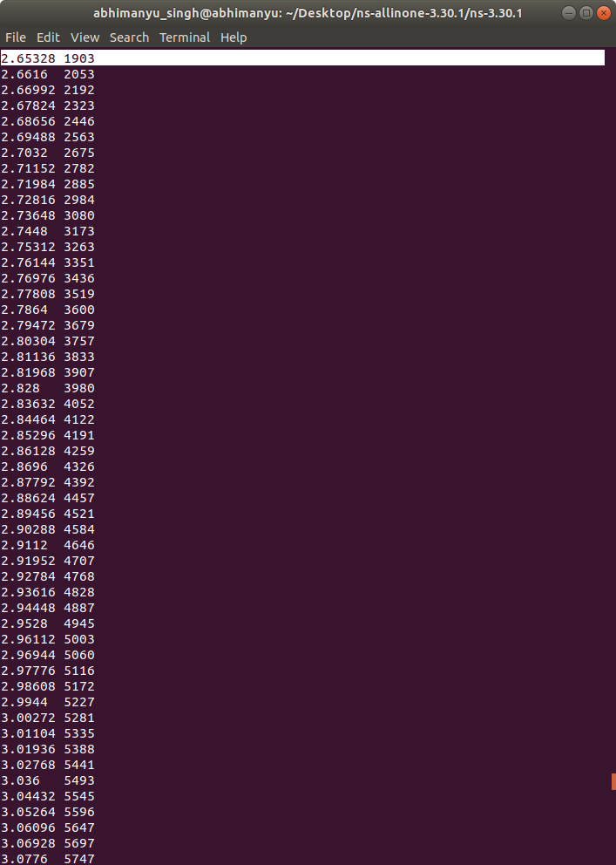
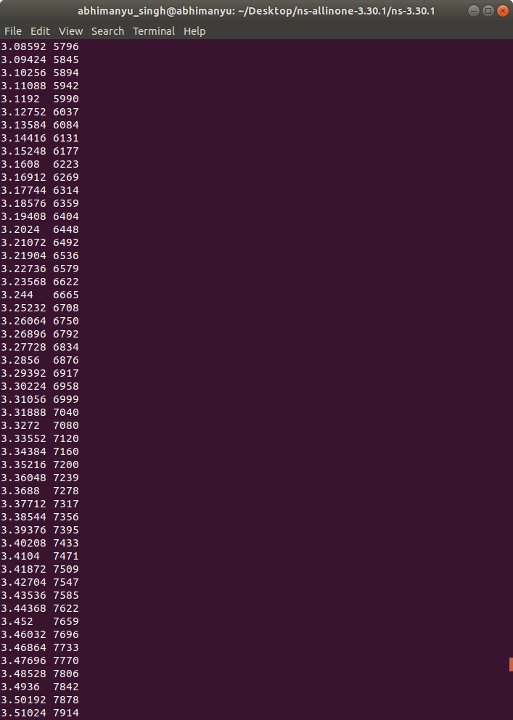
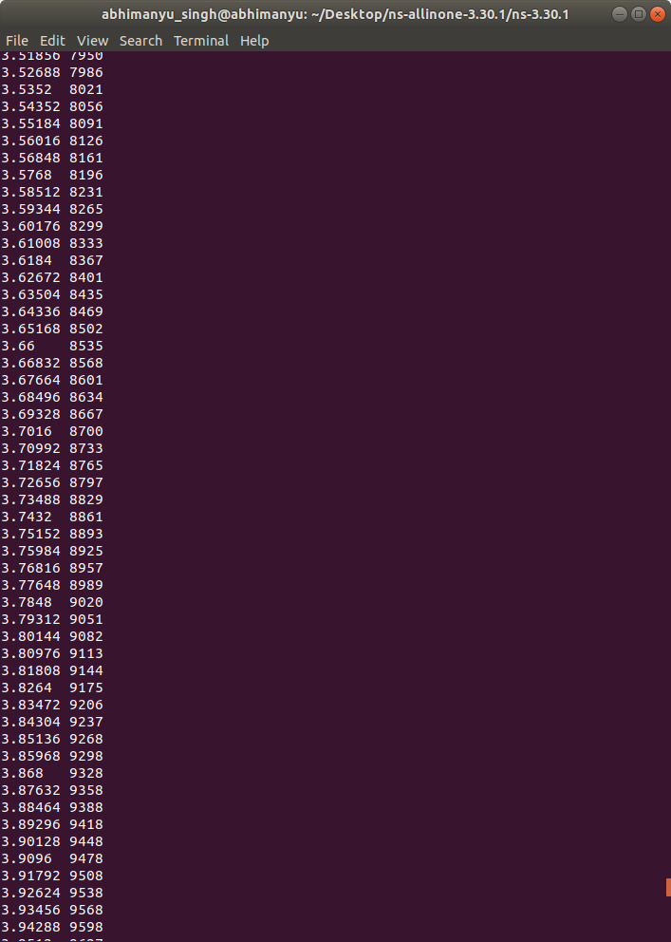

Slide 12
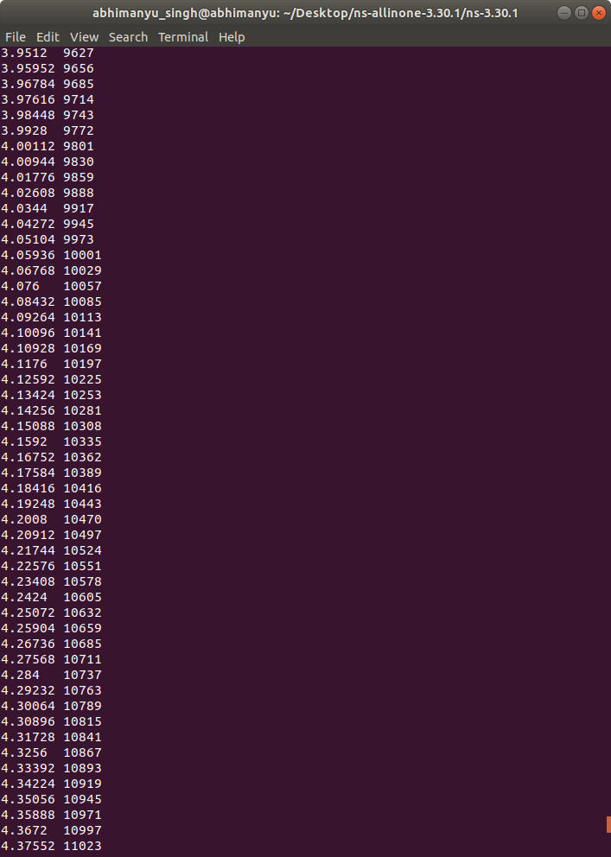
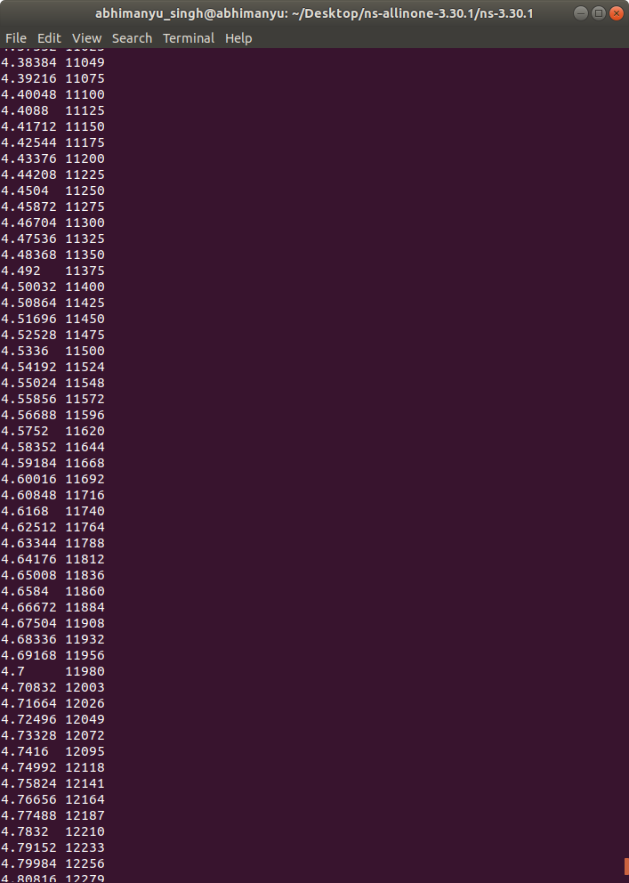
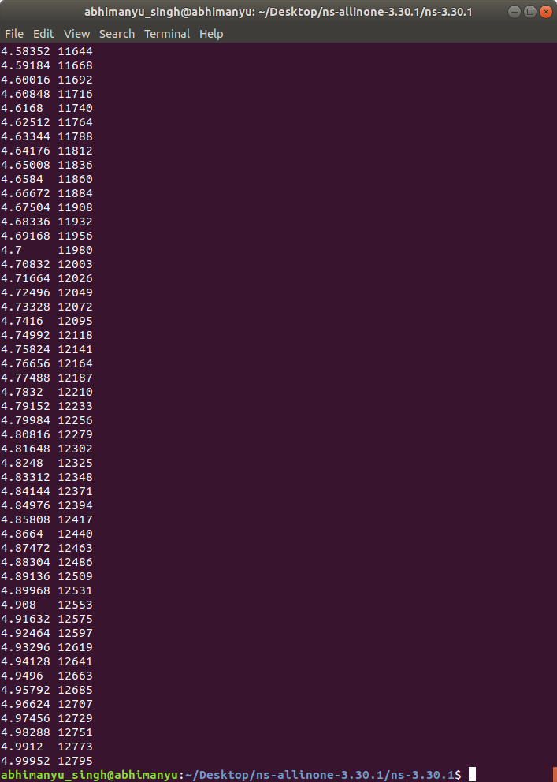

Slide 13
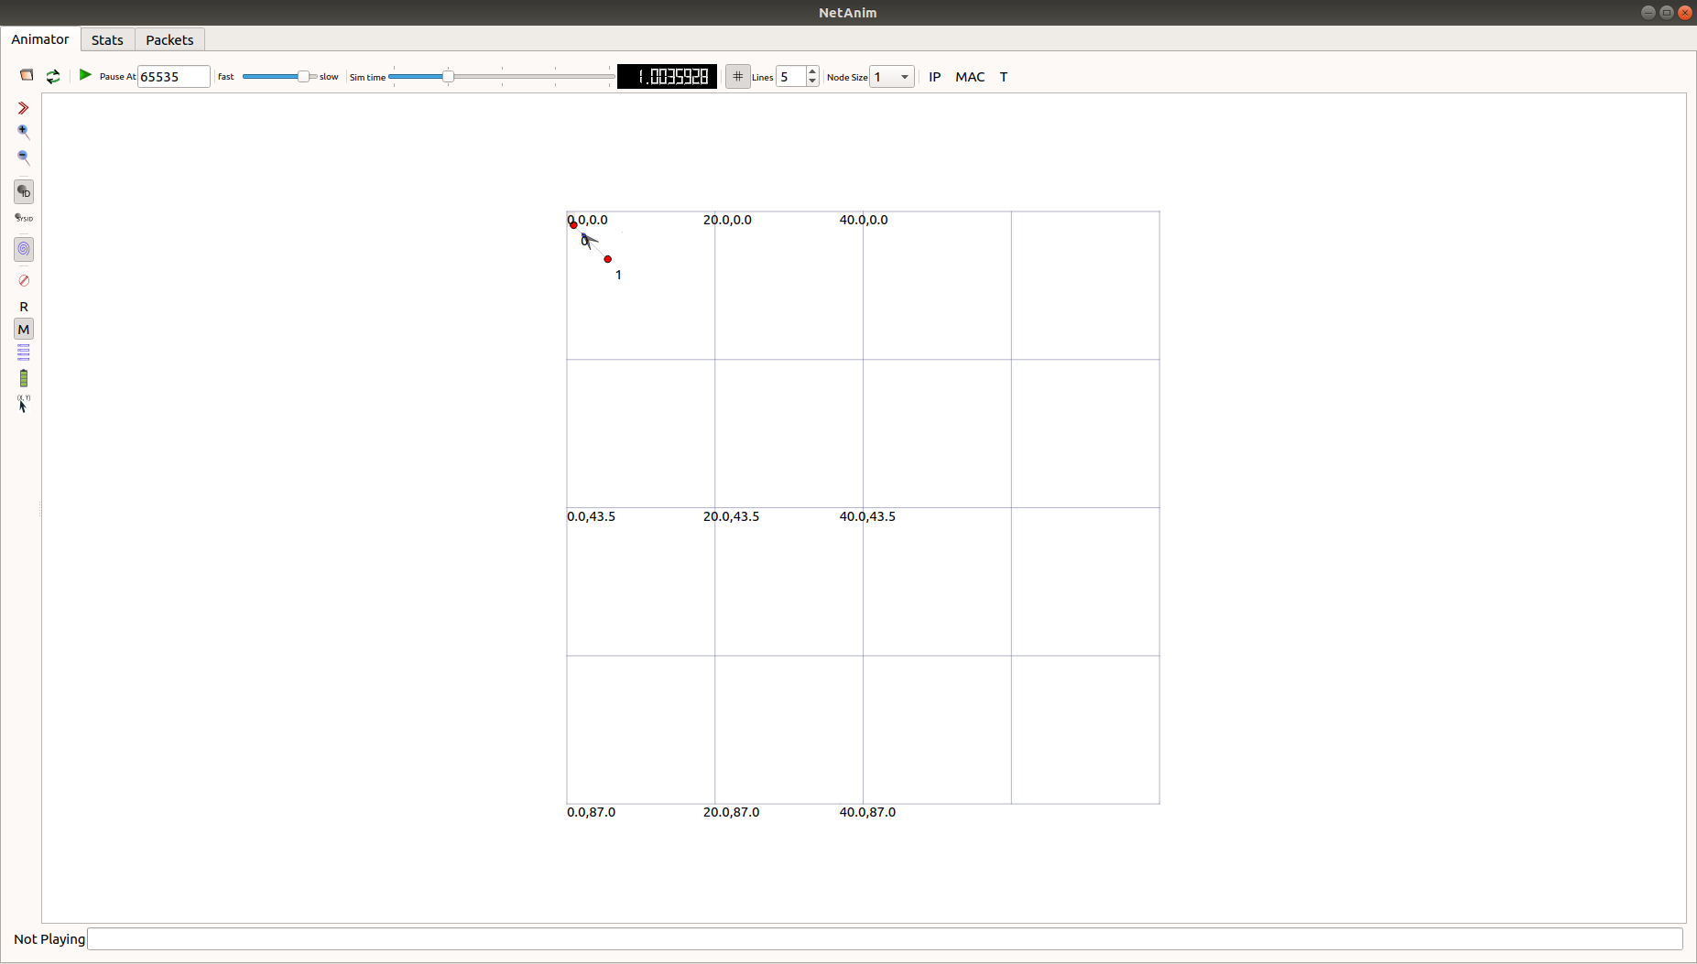
Output in netanim

Slide 14
Sixth.cc
We want to look at changes in the ns-3 TCP congestion window. We need to crank up a flow and hook the Congestion Window attribute on the socket of the sender. Normally one would use an on-off application to generate a flow, but this has a couple of problems. First, the socket of the on-off application is not created until Application Start time, so we wouldn't be able to hook the socket (now) at configuration time. Second, even if we could arrange a call after start time, the socket is not public so we couldn't get at it. So, we can cook up a simple version of the on-off application that does what we want. On the plus side we don't need all of the complexity of the on-off application. On the minus side, we don't have a helper, so we have to geta little more involved in the details, but this is trivial. So first, we create a socket and do the trace connect on it; then we pass this socket into the constructor of our simple application which we then install in the source node.

Slide 15
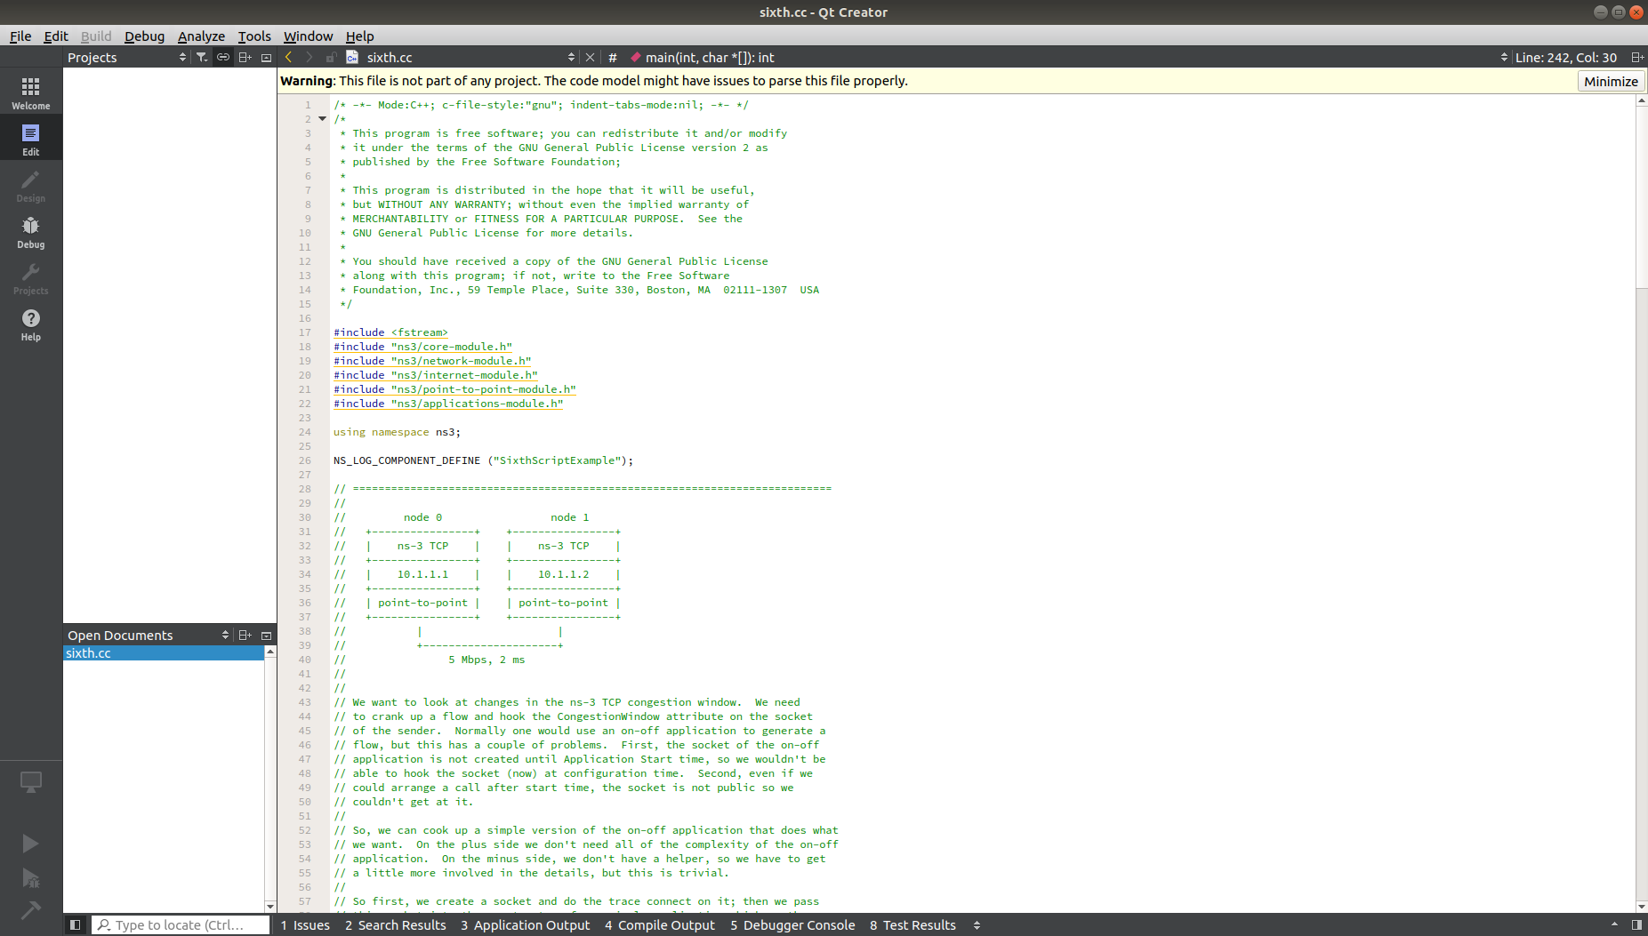

Slide 16
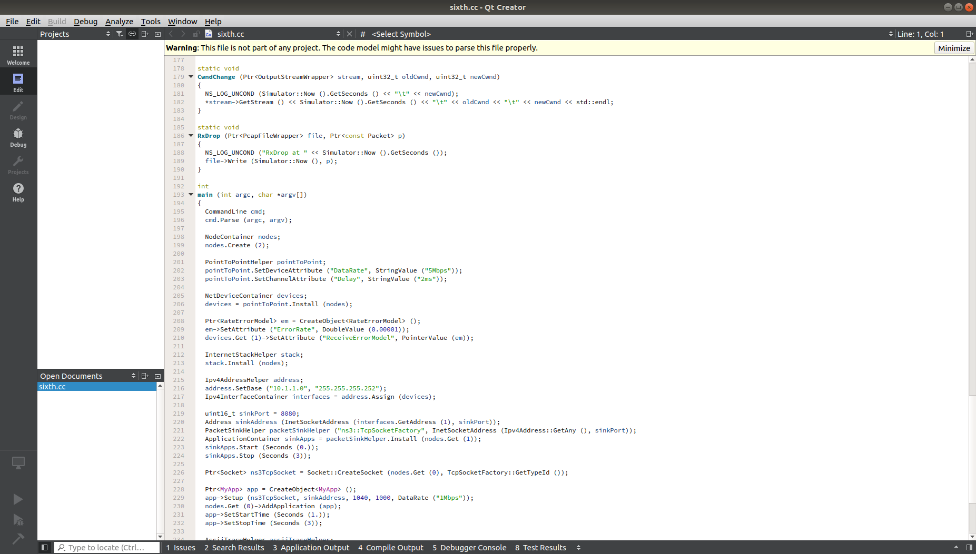

Slide 17
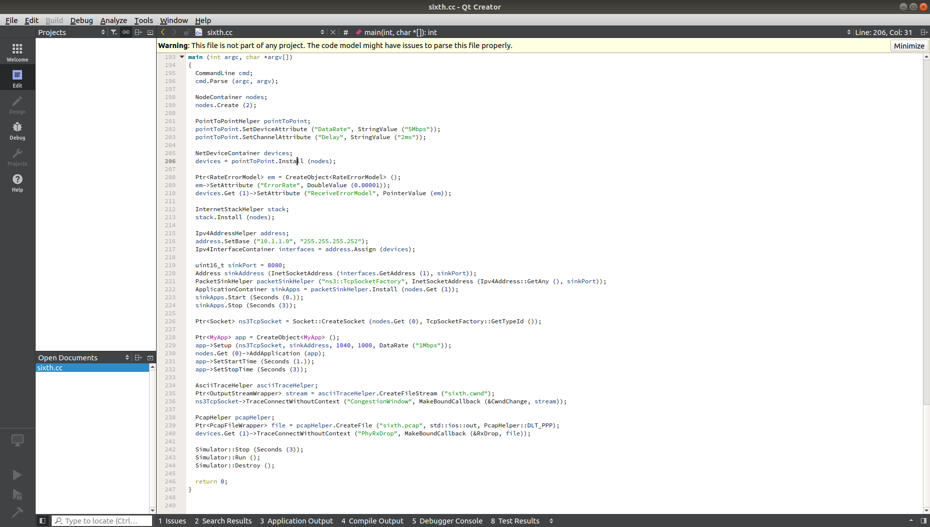

Slide 18
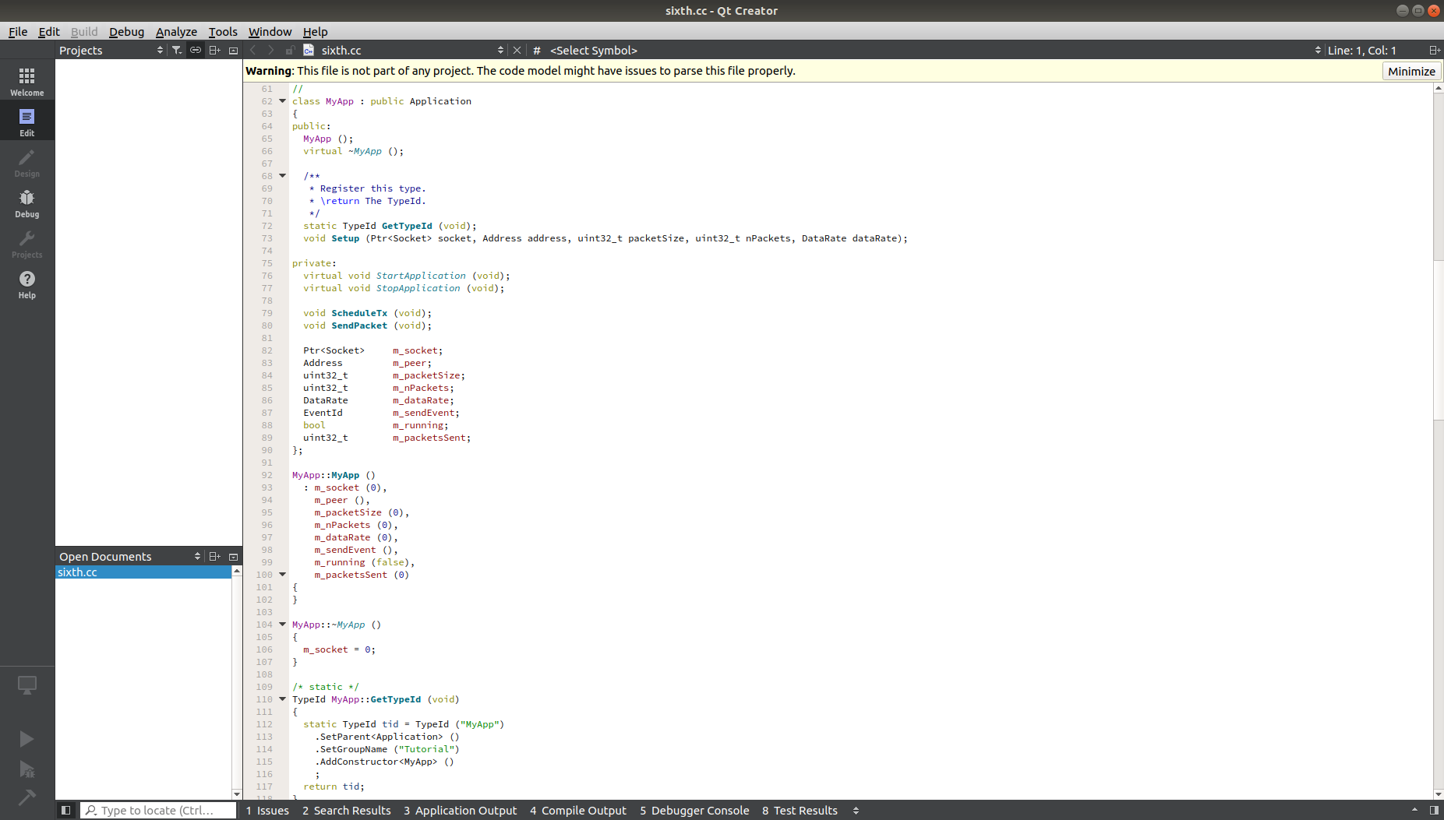

Slide 19
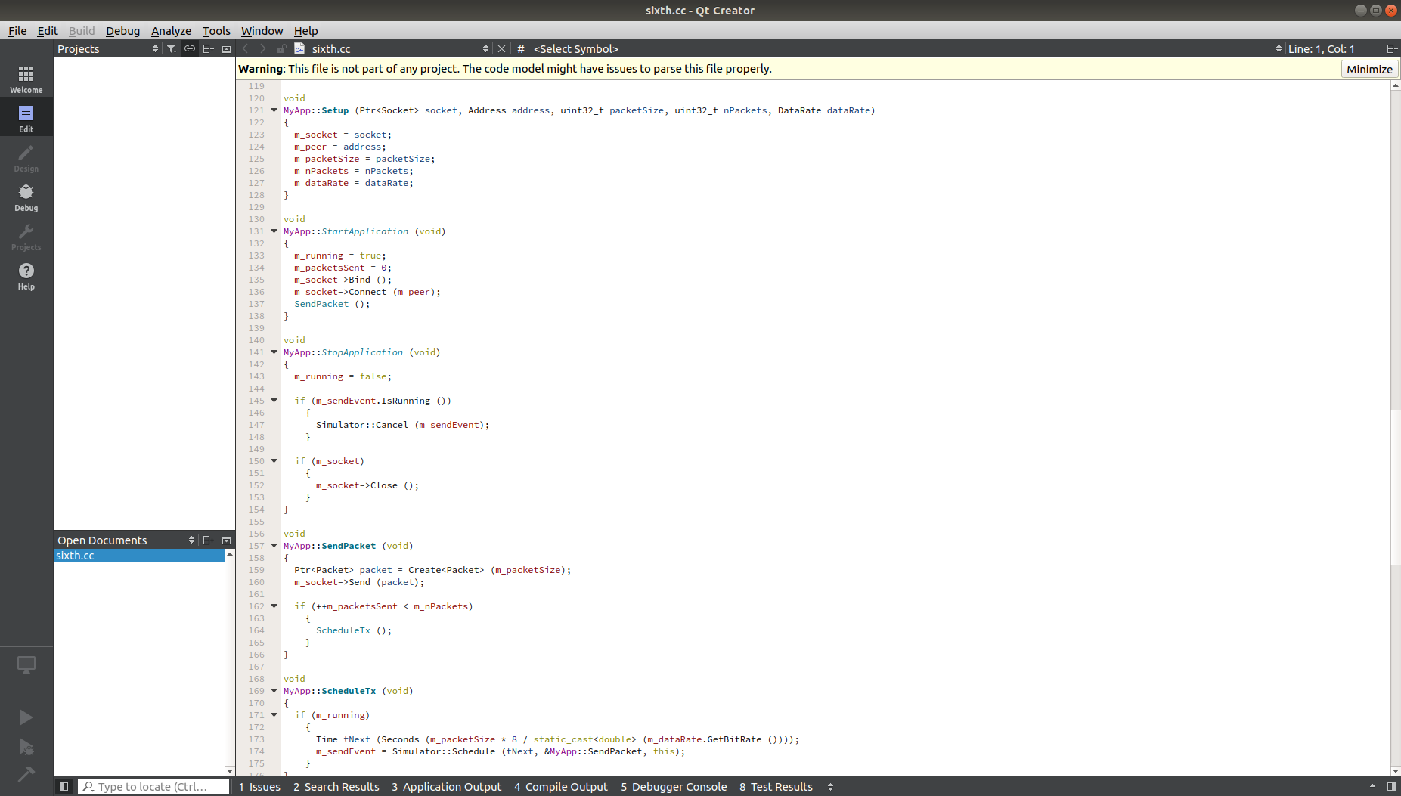

Slide 20
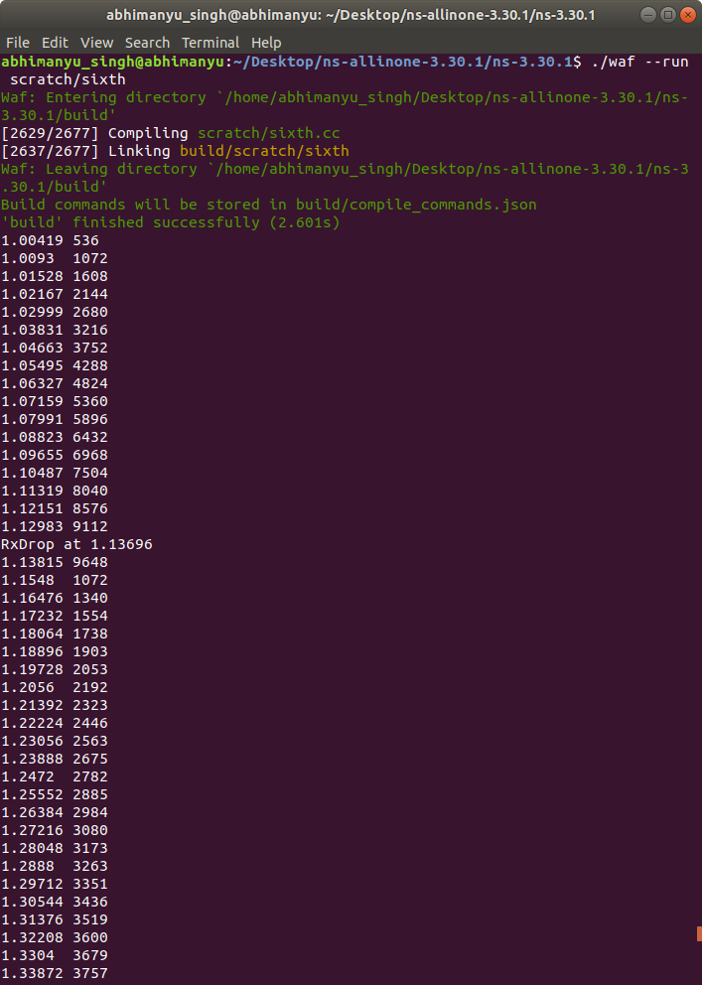
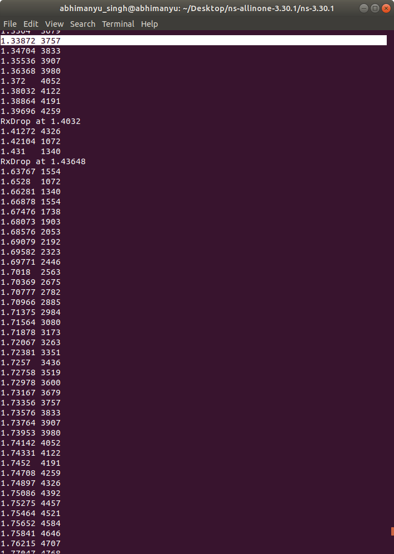
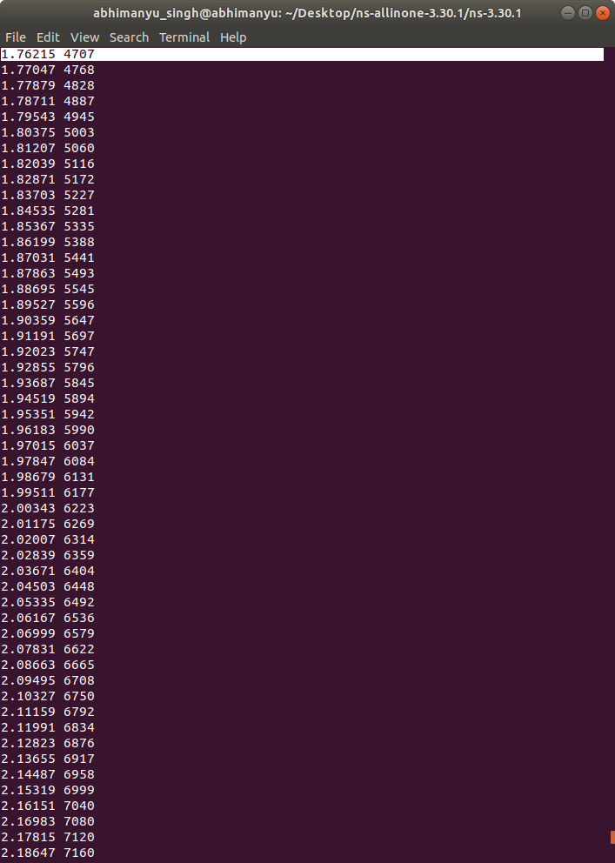
OUTPUT

Slide 21
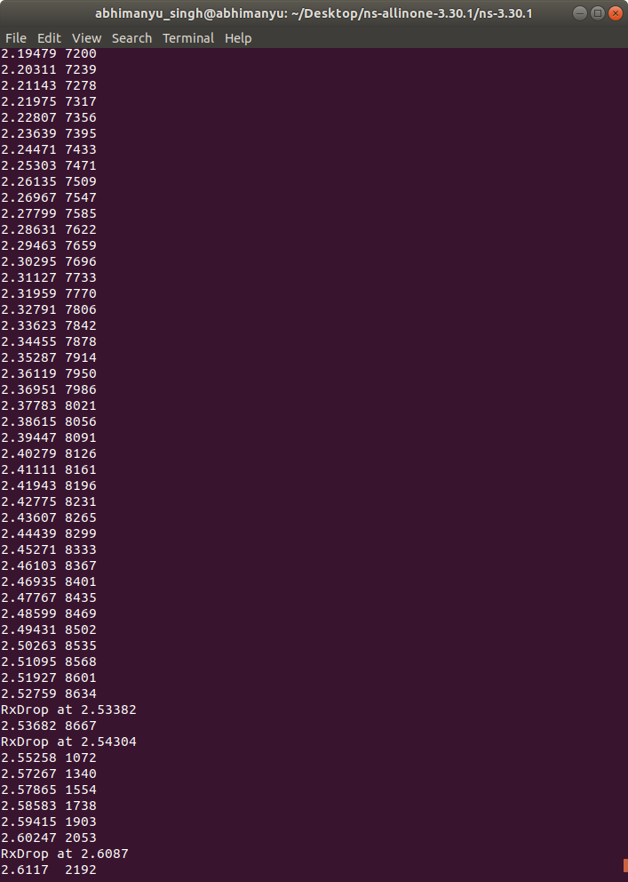
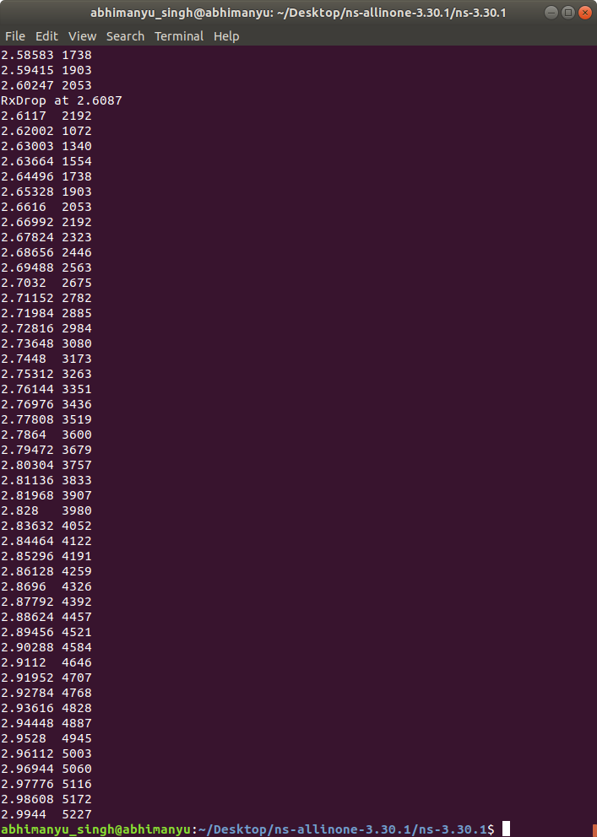

Slide 22
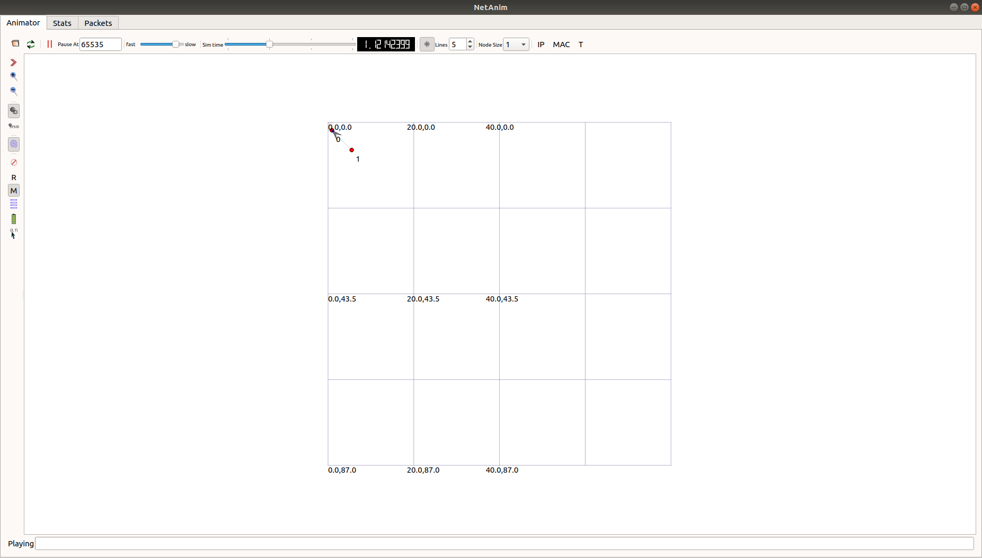
Output in NetAnim

Slide 23
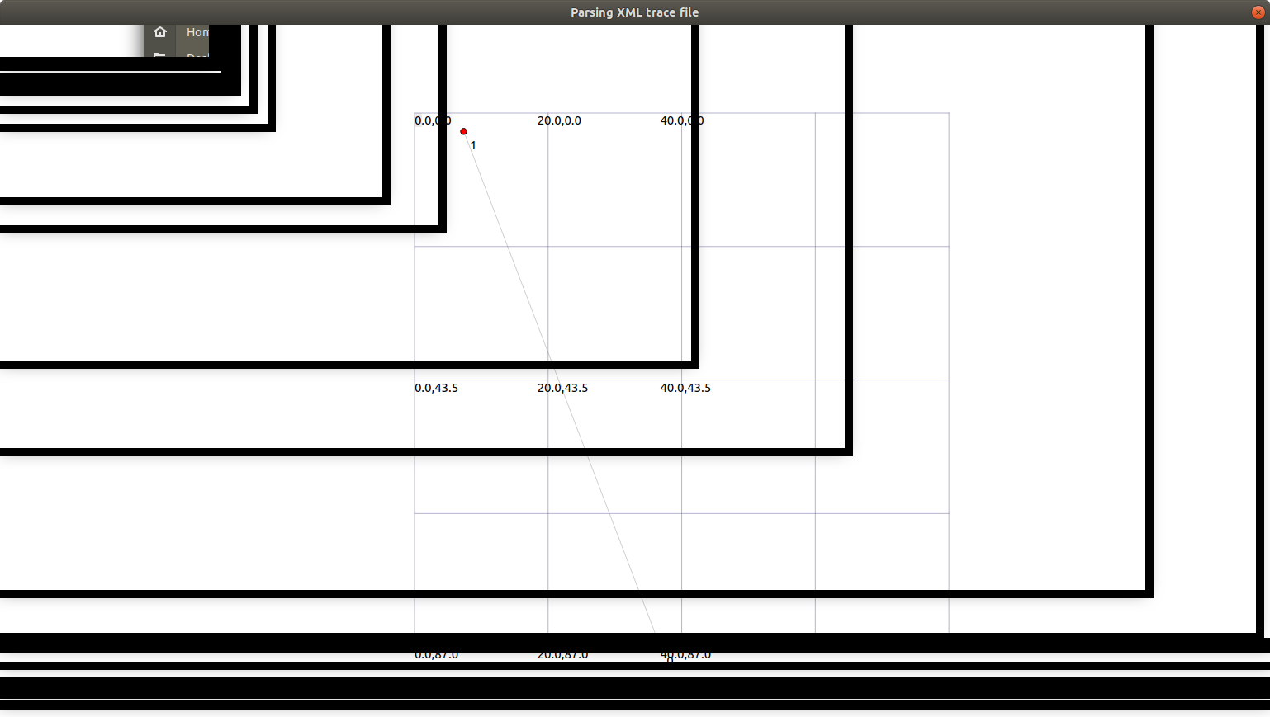
Parsing xml trace file:

Slide 24
Computer Network Topology
Geometric representation of how the computers are connected to each other is known as topology.
There are five types of topology – Mesh, Star, Bus, Ring and Hybrid.

Slide 25
Mesh Topology
In mesh topology each device is connected to every other device on the network through a dedicated point-to-point link. When we say dedicated it means that the link only carries data for the two connected devices only.

Slide 26
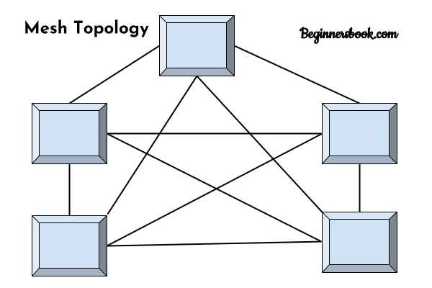
Mesh topology

Slide 27
Advantages
Advantages of Mesh topology
1. No data traffic issues as there is a dedicated link
between two devices which means the link is only
available for those two devices.
2. Mesh topology is reliable and robust as failure of one
link doesn’t affect other links and the communication
between other devices on the network. 3. Mesh topology is secure because there is a point to
point link thus unauthorized access is not possible. 4. Fault detection is easy.

Slide 28
Disadvantages
1 . Amount of wires required to connected each system
is tedious and headache.
2. Since each device needs to be connected with other
devices, number of I/O ports required must be huge.
3. Scalability issues because a device cannot be
connected with large number of devices with a
dedicated point to point link.

Slide 29
Star Topology
In star topology each device in the network is connected to a central device called hub. Unlike Mesh topology, star topology doesn’t allow direct communication between devices, a device must have to communicate throug hub. If one device wants to send data to other device, it has to first send the data to hub and then the hub transmit that data to the designated device.

Slide 30
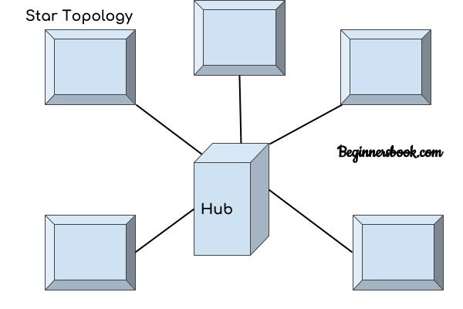
Star Topology

Slide 31
Advantages
Less expensive because each device only need one I/O port and needs to be connected with hub with one link.
2. Less amount of cables required because each device
needs to be connected with the hub only.
3. Robust, if one link fails, other links will work just fine.
4. Easy fault detection because the link can be easily
identified.

Slide 32
Disadvantages
1. If hub goes down everything goes down, none of the devices can work without hub.
2. Hub requires more resources and regular maintenance because it is the central system of star topology.

Slide 33
Bus Topology
n bus topology there is a main cable and all the devices are connected to this main cable through drop lines. There is a device called tap that connects the drop line to the main cable. Since all the data is transmitted over the main cable, there is a limit of drop lines and the distance a main cable can have.

Slide 34
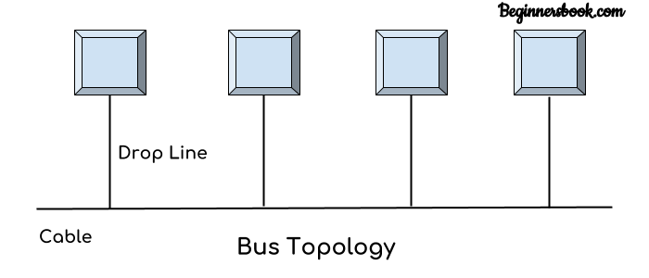
Bus Topology

Slide 35
Advantages and Disadvantages
1. Easy installation, each cable needs to be connected with backbone cable.
2. Less cables required than Mesh and star topology
1. Difficultly in fault detection. 2. Not scalable as there is a limit of how many nodes you can connect with backbone cable.

Slide 36
Ring Topology
In ring topology each device is connected with the two devices on either side of it. There are two dedicated point to point links a device has with the devices on the either side of it. This structure forms a ring thus it is known as ring topology. If a device wants to send data to another device then it sends the data in one direction, each device in ring topology has a repeater, if the received data is intended for other device then repeater forwards this data until the intended device receives it.

Slide 37
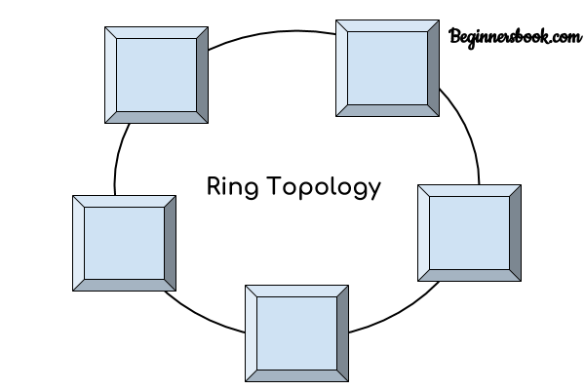
Ring Topology

Slide 38
Advantages and Disadvantages
1. Easy to install. 2. Managing is easier as to add or remove a device from the topology only two links are required to be changed.
1. A link failure can fail the entire network as the signal will not travel forward due to failure. 2. Data traffic issues, since all the data is circulating in a ring.

Slide 39
Hybrid topology
A combination of two or more topology is known as hybrid topology. For example a combination of star and mesh topology is known as hybrid topology.

Slide 40
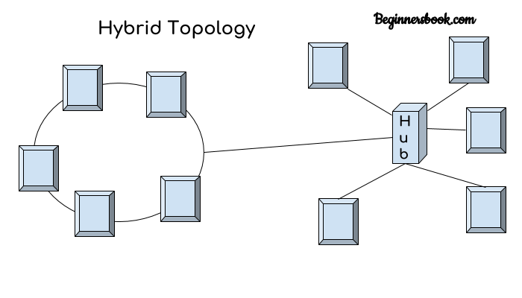
Hybrid Topology

Slide 41
Advantages and Disadvantages
1. We can choose the topology based on the requirement for example, scalability is our concern then we can use star topology instead of bus technology. 2. Scalable as we can further connect other computer networks with the existing networks with different topologies.
1. Fault detection is difficult. 2. Installation is difficult. 3. Design is complex so maintenance is high thus expensive.

Slide 42
802.11 IEEE wireless LAN standards
802.11 and 802.11x refers to a family of specifications developed by the IEEE for wireless LAN (WLAN) technology. 802.11 specifies an over-the-air interface between a wireless client and a base station or between two wireless clients.

Slide 43
Types of 802.11
1. 802.11 . applies to wireless LANs and provides 1 or 2 Mbps transmission in the 2.4 GHz band using either frequency hopping spread spectrum (FHSS) or direct sequence spread spectrum. 2. 802.11a . an extension to 802.11 that applies to wireless LANs and provides up to 54 Mbps in the 5GHz band. 802.11a uses an orthogonal frequency division multiplexing encoding scheme rather than FHSS or DSSS. 3. 802.11b . (also referred to as 802.11 High Rate or Wi-Fi) — an extension to 802.11 that applies to wireless LANS and provides 11 Mbps transmission (with a fallback to 5.5, 2 and 1-Mbps) in the 2.4 GHz band. 802.11b uses only DSSS.

Slide 44
Types of 802.11
4. 802.11g — applies to wireless LANs and is used for transmission over short distances at to 54-Mbps in the 2.4 GHz bands.
5. 802.11n — 802.11n builds upon previous 802.11 standards by adding multiple input-multiple-outupt additional transmitter and receiver antennas allow for increased data throughput through spatial multiplexing and increased range by exploiting the spatial diversity through coding schemes like Alamouti coding. The real speed would be 100 Mbit/s (even 250 Mbit/s in PHY level), and so up to 4-5 times faster than 802.11g.

